Slide 1

Website Content
Writing & Blogging
for Business
Master the Art of Digital Storytelling and Content Strategy
2026 Edition

Slide 2
Navigation
Today's Learning Journey
01
The Content Marketing Landscape
02
Website Content Strategy
2024-2025 trends and statistics
Framework and audience understanding
03
Homepage & Service Pages
04
Business Blogging
Best practices for conversion
Fundamentals and headline formulas
05
SEO & Content Optimization
06
AI & Content Creation
Modern search strategies
Leveraging technology responsibly
07
Measuring Success & Avoiding Pitfalls
Data-driven improvement and common mistakes

Slide 3
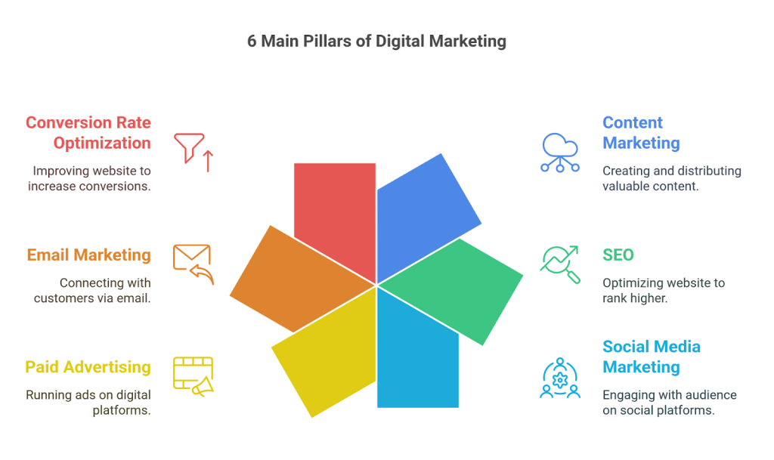

Slide 4

The Content
Marketing
Landscape
Understanding the Current State and Future of Digital Content

Slide 5
The Business Case
Content Marketing in Numbers: Why It Matters
Industry Adoption & Impact
$600B
97%
of marketers use content marketing
Industry Value
Content marketing has become essential, not optional, for business success in the digital age.
Content marketing industry worth in 2024
72%
report boosted lead generation
Businesses see significant improvements in lead quality and quantity through strategic content.
83%
62%
lower cost vs. traditional marketing
Content marketing delivers superior ROI while reducing overall marketing spend.
Quality Focus
Prioritize quality over quantity
Key Insight
Content marketing campaigns generate an average annual revenue of $984,000
Bottom Line: Content marketing isn't just a trend—it's a fundamental business strategy that drives measurable results across lead generation, cost efficiency, and revenue growth.

Slide 6
Industry Evolution
2024-2025 Content Trends Shaping the Industry
AI Integration
Zero-Click Searches
99%
60%
of marketers using AI
of Google searches
AI has shifted from experimental to essential, with 53% of marketing leaders reorganizing teams around AI capabilities.
Users find answers directly on SERPs via featured snippets and AI overviews. Optimize for visibility even without clicks.
Video Dominance
E-E-A-T Importance
91%
82.5%
Google's expanded framework emphasizes:
brands use video
of web traffic
Experience: Firsthand knowledge
Video content generates 12x more shares than image-based ads. Short-form video leads engagement.
Expertise: Subject matter depth
Authority: Credible backlinks
Trust: User signals & transparency
Voice Search Growth
Action Required: Adapt content strategy to embrace AI tools, prioritize video, optimize for voice search, and demonstrate genuine expertise in all content.
20%
of all searches
"Near me" searches surged 500%. Optimize for conversational, long-tail queries.

Slide 7

Website Content
Strategy
Framework
Building a Foundation for Effective Content

Slide 8
Strategic Foundation
The 7-Pillar Content Strategy Framework
1
2
3
Goals & KPIs
Target Audience
Messaging & Voice
Define SMART goals. Map to measurable KPIs: conversions, traffic, engagement.
Document key audiences. Map needs at each funnel stage: awareness, consideration, decision.
Create brand messaging guidelines reflecting personality and values. Include voice and tone examples.
Example: "Increase organic traffic by 20% in 6 months"
Create detailed customer avatars
Consistent tone across all channels
4
5
6
Content Pillars
Formats & Channels
Workflow & Governance
Pick 3-5 core themes you want to be known for. Align with expertise, audience interests, and business goals.
Decide content types and where each lives. Tailor format to platform usage.
Define how content moves from idea to published. Outline steps, roles, timelines.
Build topical authority
Multi-channel approach
Document the entire process
Measurement & Optimization
7
Traffic
Engagement
Conversions
Set KPIs for each content type. Track performance with analytics tools. Double down on what works, adjust what doesn't.
Notes:
The 70-20-10 Rule: Allocate 70% of content to education, 20% to engagement, and 10% to promotion.

Slide 9
Audience Intelligence
Understanding Your Target Audience Deeply
1. Goals & Values
4. Challenges & Pain Points
What is your avatar trying to achieve? What values do they hold dear?
What holds them back from achieving their goals?
Content Application: Create content that helps them achieve goals and aligns with their values
Content Application: Create problem-solving content that addresses specific pain points
2. Sources of Information
5. Objections
What books, magazines, blogs, and publications do they reference?
Why might they choose not to buy your product or service?
Content Application: Guest post on those platforms, reference those sources, appear where they look
Content Application: Address objections head-on in your content with evidence and testimonials
3. Demographics
What is the age, gender, income, location, and job title of your avatar?
Action Framework
Use avatar insights to create content that:
Content Application: Tailor language, examples, and tone to match their demographic profile
Solves their problems
Enters their conversations
Speaks to their goals
Meets objections directly

Slide 10

Homepage & Service
Page
Excellence
Creating High-Converting Website Content

Slide 11
Conversion Optimization
Homepage Content: The 5-Element Formula
1
Clear & Concise Message
4
Trust Elements
Who you are and what you offer—instantly clear within 3 seconds
Testimonials, case studies, certifications, client logos, security badges
Example: Mint: "Your financial life, all in one place"
Testimonials
Security
2
Strong Headline
Awards
Client Logos
Simple, engaging, and problem-solving. No jargon.
Example: Dropbox: "Your stuff, anywhere"
5
Strategic CTA
Clear next step with action-oriented language
3
Value Proposition
Strong: "Start Your Free Trial"
Why choose you over competitors? What's your unique advantage?
Strong: "Get Started Free"
Example: Slack: "Where work happens" + productivity benefits
Strong: "See How It Works"
Pro Tip: The best homepages (like Mint and Dropbox) embrace simplicity, limit copy and visuals, and use whitespace strategically. Focus on ONE primary CTA.

Slide 12
Conversion Copywriting
Service/Product Pages That Convert
Essential Elements
Copywriting Formulas
Compelling Headline
AIDA Formula
Benefit-focused, not feature-focused
Benefits Over Features
Attention: Grab with headline
Explain how it solves customer pain points
Interest: Build with benefits
Social Proof
Desire: Create with social proof
Testimonials, reviews, case studies
Action: Drive with CTA
Clear CTA
Action-oriented, specific next step
4Ps Formula
Visual Support
Promise: What's in it for me?
Images, videos, demos, infographics
Picture: Paint the outcome
Proof: Back up with evidence
Common Mistake
Push: Clear call to action
Focusing on product features instead of customer benefits. Customers don't buy features—they buy solutions to their problems.
4Cs Checklist
Clear
Concise
No confusion
No fluff
Compelling
Credible
Engaging
Trustworthy

Slide 13

Business Blogging
Fundamentals
Turning Your Blog Into a Business Growth Engine

Slide 14
Business Impact
Why Blogging Is Non-Negotiable for Business
Boosts SEO
Engages Audience
Search engines love fresh, relevant content. Blogging improves website ranking, making it easier for customers to find you. 68% of online experiences begin with a search engine.
Blogs provide a platform to interact through comments, shares, and feedback.
Builds Trust & Authority
Supports Social Media
Sharing valuable insights positions your business as an expert in your field. 73% of B2B marketers consider content marketing the most effective strategy for generating leads.
Blog content can be repurposed for social media, email campaigns, and other channels.
Drives Traffic
Blogging Statistics
Blogs attract visitors to your website, increasing chances of converting them into customers. Businesses that consistently blog experience 13x higher positive ROI.
83%
read blogs daily
7 minutes
optimal reading time
80%
more traffic for listicles
The Reality: Blogging is no longer optional—it's a necessity. It's a cost-effective way to connect with your audience, improve online presence, and drive sustainable growth.

Slide 15
Content Structure
The Anatomy of High-Impact Blog Posts
Compelling Headline
Strong Introduction
Scannable Structure
Engaging Visuals
Clear, keyword-optimized, attention-grabbing. Front-load keywords.
Hook readers immediately. State the problem, promise the solution.
Short paragraphs (4-5 lines max), bullet points, subheadings.
Images, infographics, videos. Articles with 7+ images see 116% more traffic.
Promise value
First 100 words critical
Most readers are skimmers
Break up text
Optimal Blog Post Specifications
Strategic CTAs
Quality Media
1,400
7 min
7+
Subscribe, share, purchase. Every post needs a purpose.
Fast-loading, relevant images and videos. Avoid stock photos when possible.
Average words per post
Optimal reading time
Images for best traffic
Clear next step
Under 3 sec load time

Slide 16
Click-Worthy Titles
Blog Headline Formulas That Drive Clicks
Self-Interest
Urgency & Scarcity
Direct and speak to a specific benefit. Answer "What's in it for me?"
Communicate that readers must act now or miss something.
"Grow Your Website Traffic with the 3-Step Content Marketing Plan"
"Get Tickets Now! Woody Allen Speaking at Lincoln Center on October 15th"
"How to Retire in Style Even if You Haven't Started Saving"
"Free Photography Classes: Last Chance for Open Enrollment"
"Top 10 Organic Food Markets in Austin, Texas"
"New Book Reveals Ancient Weight Loss Secret; Supplies are Limited"
Best for: How-to content, listicles, guides
Best for: Time-sensitive offers, limited quantities
Curiosity
Warning
Pique interest without giving away too much. Hard to resist clicking.
People are more motivated to avoid pain than gain benefit.
"25 Things You Didn't Know Your iPhone Could Do"
"The Big Lie Hiding in Your Apartment Rental Contract"
"Grill the Perfect Beef Filet with the 'Butterfly Process'"
"Warning: Don't Buy Another Ounce of Dog Food Until You Read This"
"This is Why You Should Never Drink Raw Milk"
"Is Your Child's Mattress Harmful to His or Her Health?"
Caution: Don't mislead—content must deliver on promise
Best for: Safety, health, financial content

Slide 17

SEO & Content
Optimization
Getting Found in the Search Results

Slide 18
Search Evolution
Modern SEO: Beyond Keywords to Intent
Search Intent
E-E-A-T Framework
Google's expanded quality framework:
Why users search matters more than what they search. Understanding intent helps create content that truly satisfies user needs.
E
Experience
Firsthand knowledge
Informational
Navigational
Transactional
E
Expertise
"How to..."
"Brand name"
"Buy..."
Subject matter depth
A
Authority
Credible backlinks
Topic Clusters
T
Trustworthiness
User signals, transparency
Create pillar pages on broad topics, then link to focused cluster content. Builds topical authority and improves SEO.
Zero-Click Searches
Structure: Pillar Page (broad topic) → Cluster Content (specific subtopics) → Internal linking
60%
of Google searches end without a click
Voice Search Optimization
Optimize for featured snippets, knowledge panels, and AI overviews to capture visibility even without clicks.
20% of searches are voice-based. Optimize for conversational, long-tail queries.
Example: Instead of "best pizza NYC," optimize for "where can I find the best pizza in New York City?"

Slide 19
SEO Checklist
Strategic Keyword Placement Framework
Post Title
Introduction & Conclusion
Front-load your target keyword in the title
Natural keyword use in opening and closing paragraphs
Good: "Content Marketing Strategy: 7 Steps to Success"
Tip: Use within first 100 words
URL Structure
Headers (H1, H2, H3)
Clean, keyword-rich URLs
Include keywords in subheadings for structure and SEO
Good: /content-marketing-strategy/
Structure: One H1, multiple H2s and H3s
Meta Description
Avoid Keyword Stuffing
Compelling summary with keyword included
Natural language always wins. Write for humans first, search engines second.
Limit: 150-160 characters
Bad: "Our content marketing strategy content marketing helps with content marketing..."
Good: "Our content marketing strategy helps businesses grow through valuable, engaging content..."
Image Alt Text
Descriptive, keyword-appropriate alt text for all images
Long-Tail vs Short-Tail
Good: "Content marketing strategy workflow diagram"
Short-Tail
Long-Tail
"Marketing"
"B2B content marketing strategy"
High volume, high competition
Lower volume, higher intent

Slide 20

AI & Content
Creation
Leveraging Artificial Intelligence Responsibly

Slide 21
Industry Transformation
AI in Content Marketing: The New Reality
AI Adoption Statistics
The Critical Statistic
99%
80%+
86%
of marketers using AI
use AI in digital strategies
still edit AI-generated content
53%
49%
Human oversight remains essential for brand voice, accuracy, and quality.
reorganized teams for AI
create complex AI prompts
AI as Partner, Not Replacement
How Marketers Use AI
AI handles heavy lifting of first drafts
Humans add brand voice and expertise
Brainstorming & Ideation
— Topic generation, creative prompts
AI solves content creation at scale
First Drafts
— Outlines, introductions, rough content
Humans ensure authenticity and trust
Editing & Optimization
— Grammar, readability, SEO
Content Repurposing
— Blog to social, video scripts
Key Insight: The question isn't whether to use AI—it's how to use it strategically while maintaining human quality control.

Slide 22
Responsible AI Use
Best Practices for AI-Assisted Content Creation
Start with AI, Don't End with AI
Craft Great Prompts
Add Specific Examples
Use AI for idea generation and rough drafts. Then apply human refinement for brand voice and quality.
Be specific, provide context, ask open-ended questions. The quality of output depends on the quality of input.
AI excels at big-picture output but needs guidance on specifics that make content valuable and unique.
Clear goal
Think of AI as your brainstorming partner, not your ghostwriter
Specific instructions
Context provided
Include specific situations, data points, and case studies
Remove AI "Tells"
Insert Your Personality
Fact-Check Everything
Identify and eliminate AI patterns: overused phrases, generic conclusions, excessive em-dashes.
Adjust AI voice to match your brand. Try different AI models to find the best fit for your style.
AI can generate plausible-sounding but incorrect information. Always verify facts, statistics, and claims.
"In conclusion..."
Overused em-dashes
Generic phrases
ChatGPT vs Claude write differently—test both
Use plagiarism detection tools
Remember: The difference between good AI content and great content isn't the technology—it's whether you're willing to put in the work after the AI stops typing.

Slide 23

Measuring Success
& Avoiding
Pitfalls
Data-Driven Content Improvement

Slide 24
Performance Measurement
Key Metrics to Monitor Content Performance
Traffic Metrics
Engagement Metrics
SEO Performance
Conversion Metrics
Social Metrics
Measure content reach and visibility
Measure content quality and resonance
Measure search visibility and ranking
Measure business impact and ROI
Measure social amplification
Page views
Time on page
Keyword rankings
CTA clicks
Shares
Unique visitors
Bounce rate
Organic traffic
Newsletter signups
Likes
Traffic sources
Comments
Backlinks
Leads generated
Mentions
Essential Tools for Measurement
Google Analytics
Search Console
Social Analytics
Email Analytics
Traffic & behavior
SEO performance
Platform insights
Open & click rates

Slide 25
Pitfall Prevention
Common Content Mistakes to Avoid
Ignoring SEO
Inconsistent Posting
Over-Promotion
Neglecting Mobile
Failing to optimize limits your blog's reach and discoverability.
Irregular updates lead to loss of audience interest and SEO momentum.
Constantly selling instead of providing value turns readers away.
Non-responsive design loses majority of mobile traffic.
Fix: Optimize every piece with keywords, meta descriptions, and alt text
Fix: Create editorial calendar, publish biweekly minimum
Fix: Follow 80% value, 20% promotion rule
Fix: Ensure responsive design, test on all devices
Skipping Proofreading
No Clear CTA
Keyword Stuffing
Thin Content
Typos and errors harm credibility and professionalism.
Every piece needs purpose—what should readers do next?
Unnatural keyword repetition hurts readability and SEO.
Surface-level content doesn't provide real value or rank well.
Fix: Use Grammarly, always proofread before publishing
Fix: Include strategic CTA in every post
Fix: Write naturally, use keywords contextually
Fix: Depth beats breadth—invest time in quality
Success Formula: Avoid these common pitfalls by following best practices, measuring performance, and continuously iterating based on data.

Slide 26

Your Content Journey Starts Now
Key Takeaways
Essential for Growth
Strategy First
Content marketing is essential for business growth in 2024-2025. 97% of marketers use it for a reason—it works.
Strategy comes before creation—know your audience, goals, and messaging before writing a single word.
Quality Over Quantity
AI as Tool
Quality always beats quantity. 83% of marketers prioritize quality, and readers reward depth over volume.
AI is a powerful tool when used responsibly. 86% still edit AI content—human oversight is non-negotiable.
Remember: Great content serves your audience first and your business second.
Measure, learn, and continuously improve. Your content journey is a marathon, not a sprint.

